Slide 1
Rice Datathon 2023: Beginners Track Challenge
By: Karthik Kallakuri, Michael Moorman, Abraar Patel, Aadarsh Srivatsav
Notes:
Michael

Slide 2

Problem and Solution
Identify characteristics of facilities where putting funds would make the most impact
Use census and facilities data that contains age, sex, and race to identify the locations where opening facilities would make the most sense
Maximizing impact of expanded medical access:
Utilizing a dataset of FDA certified facilities: expand medical access
Supplemented by census dataset, demographic data that correlates to facilities
Notes:
Michael

Slide 3
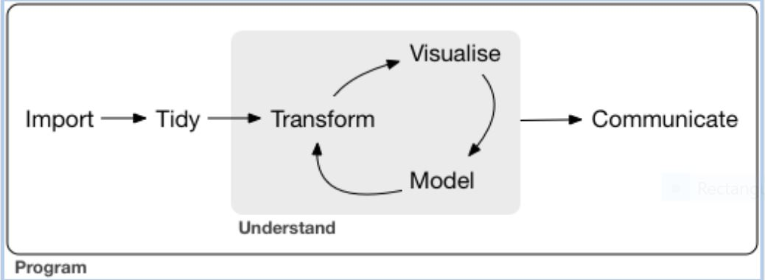
Map
Notes:
Karthik

Slide 4
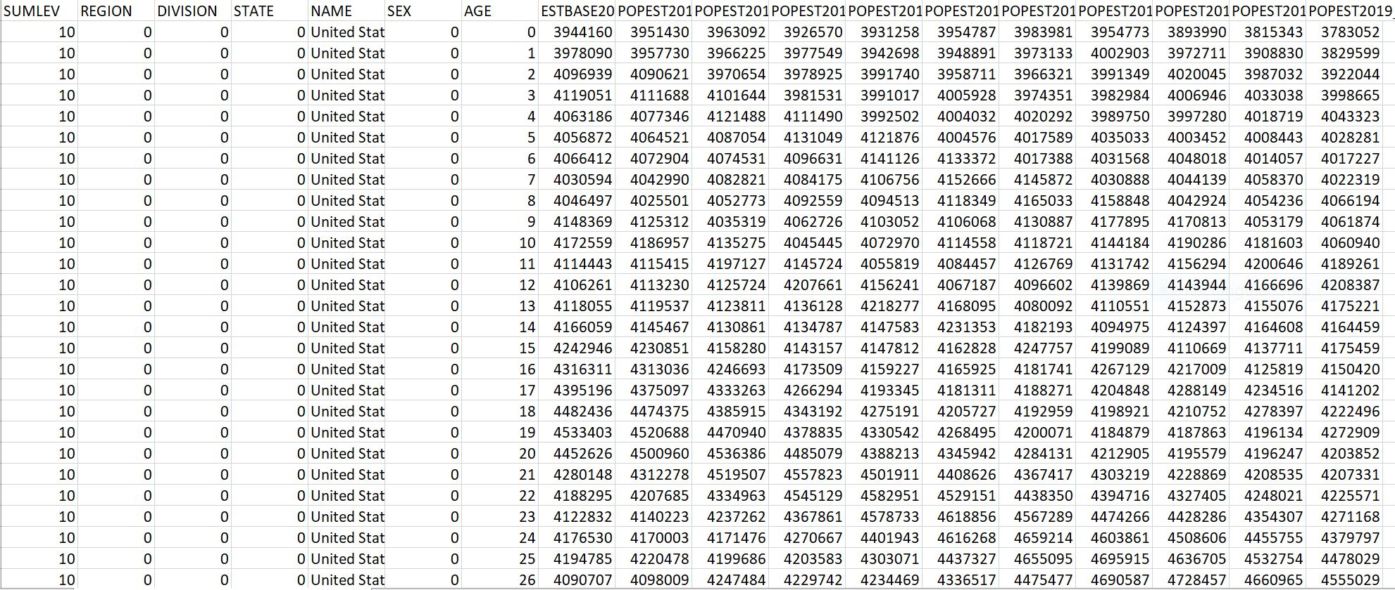
Agesex.csv datafile
Notes:
Karthik

Slide 5
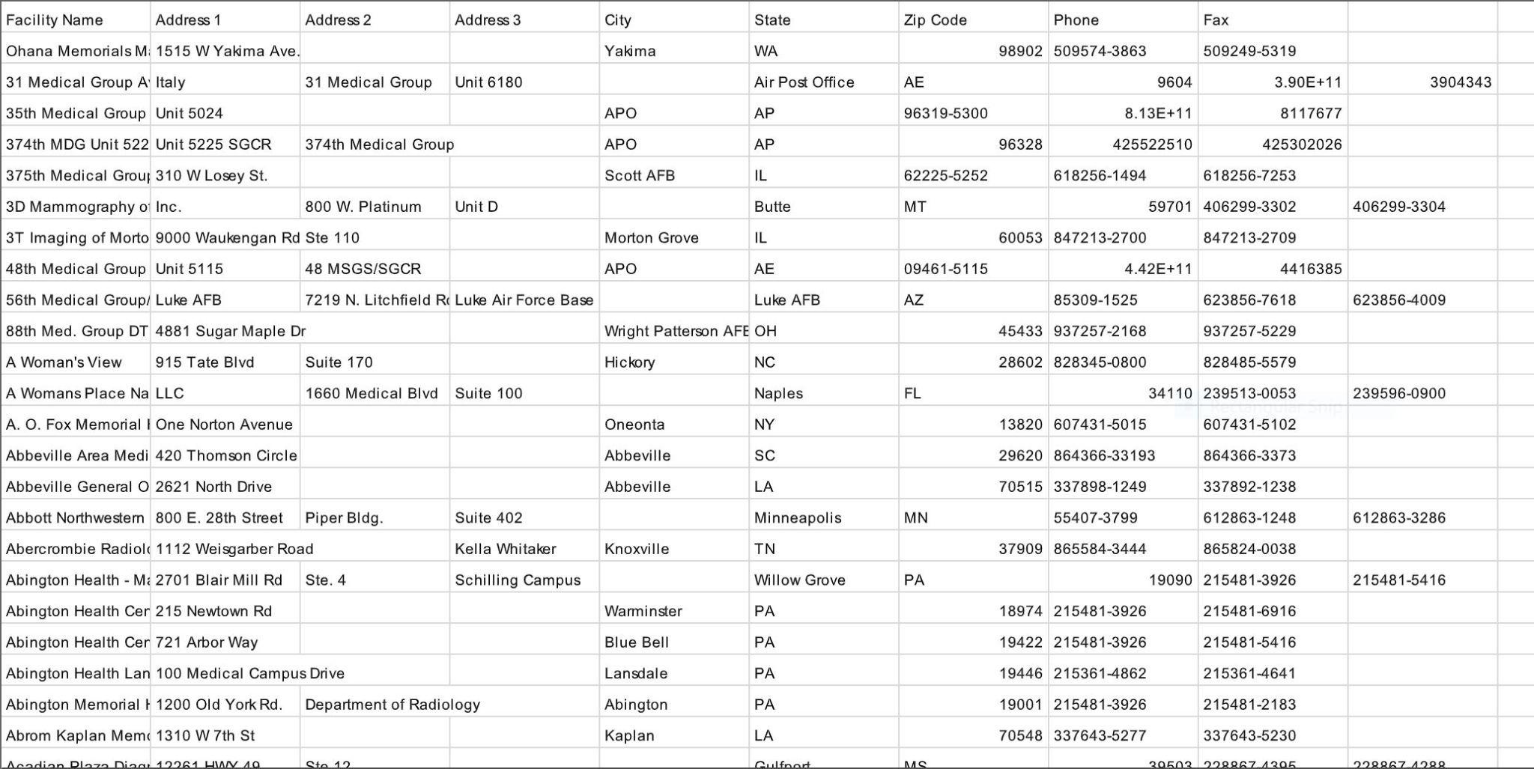
Beginner.csv datafile
Notes:
Karthik

Slide 6
Cleaning and Processing
Organize the dataset that contains the facilities location; make it more it more organized and format it so it can be used by python to analyze, Model and Visualize
Sort and Filter the census data to only include relevant information
Remove spurious column like SUMLEV, Division and Region
Remove all male data because it is not apply to our analysis
Remove data of ages that are not applicable for mammography or breast cancer
Sort the FDA data about the facilities
write a manual csv parser to get the columns
ignore AE and other state codes not in our selection of 52
ignore Facility Name column and Address
Getting rid of other unnecessary data like duplicates and Nulls
Notes:
Karthik

Slide 7
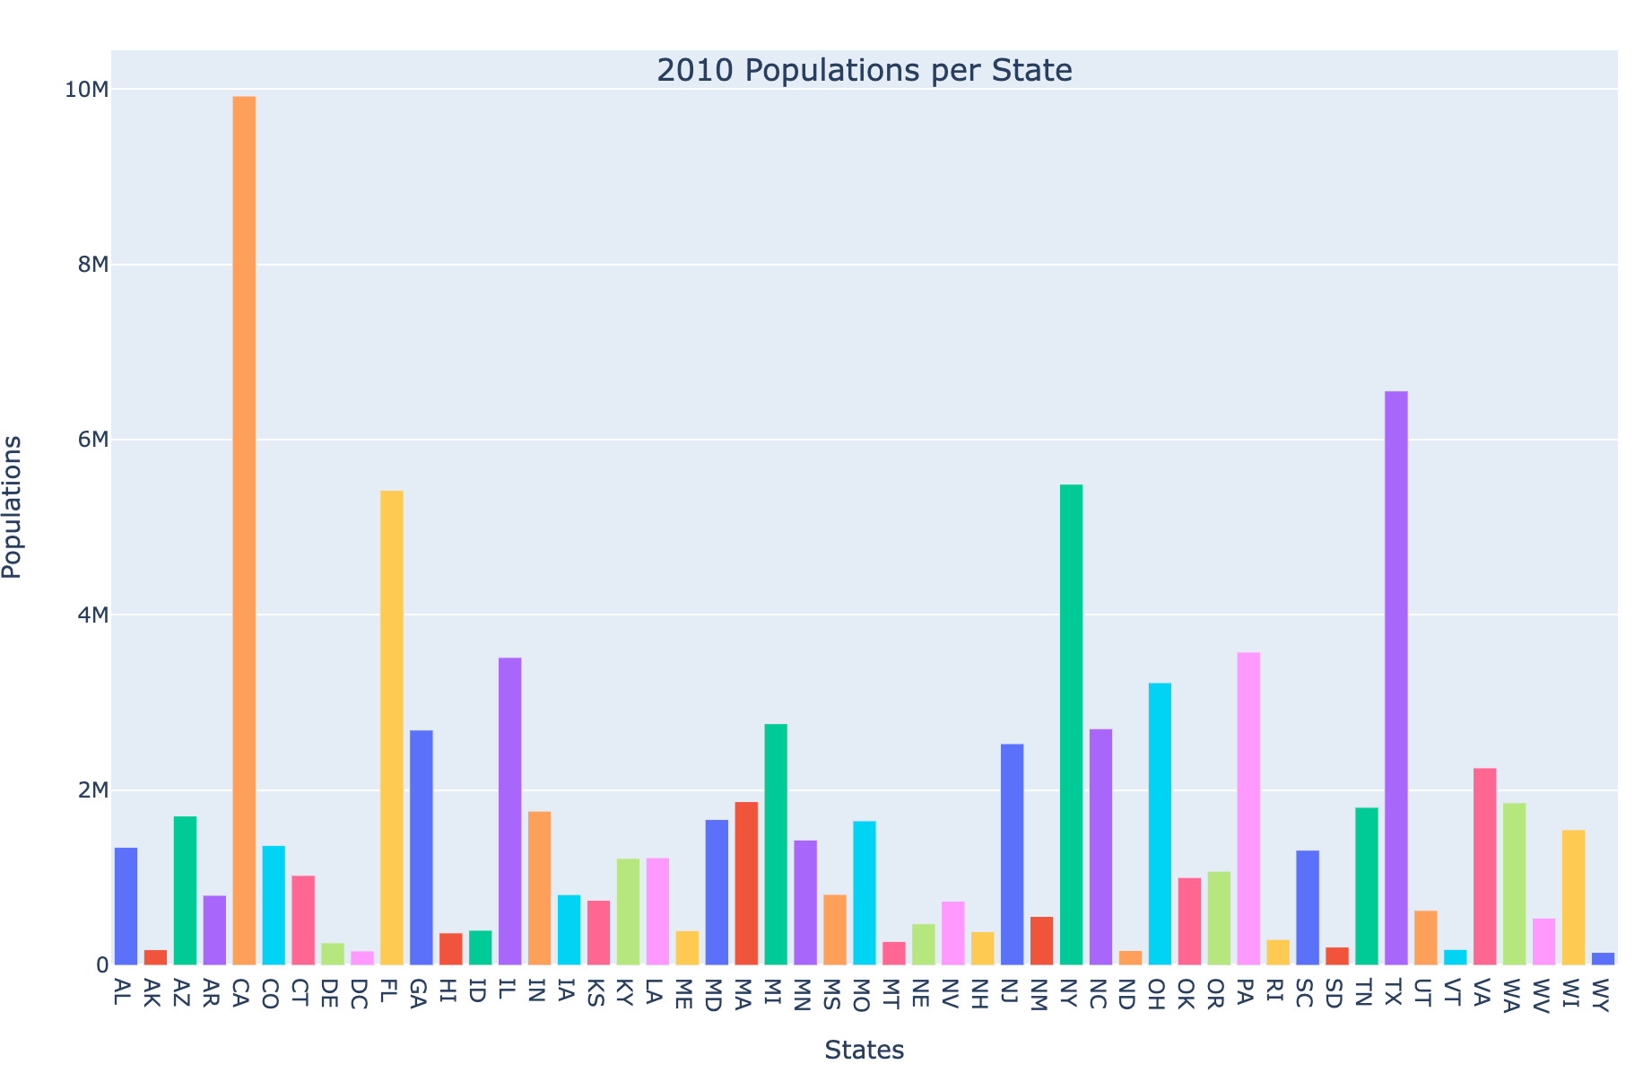
Modeling and Visualization - 2010 Population
Notes:
Aadarsh

Slide 8
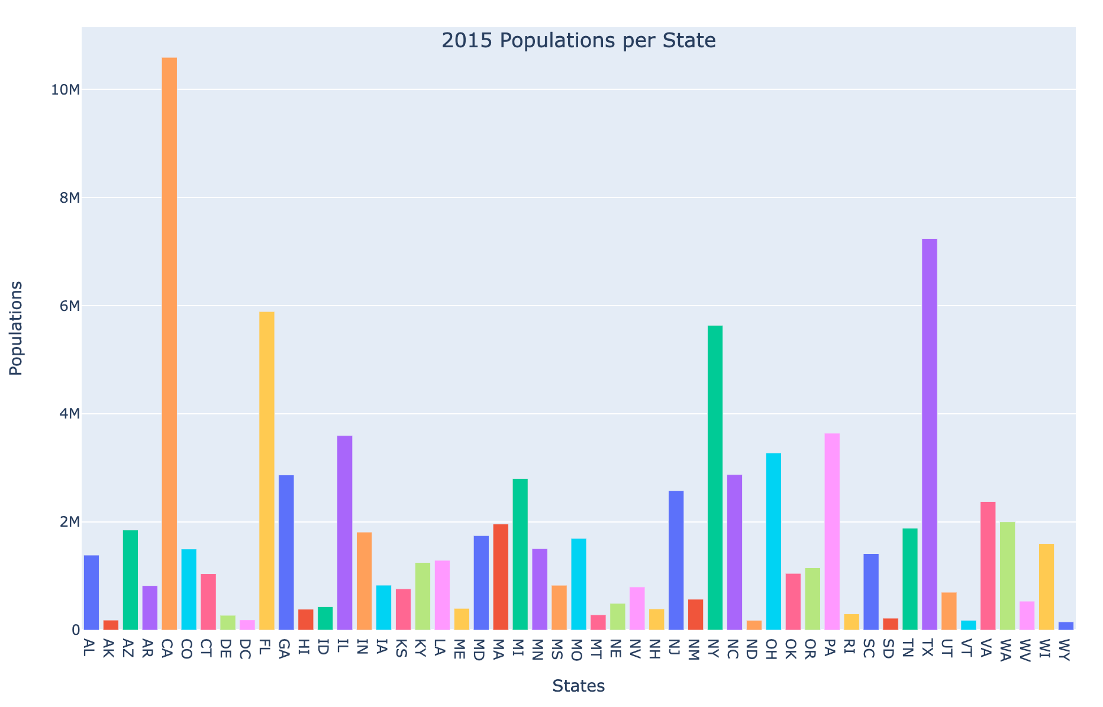
Modeling and Visualization - 2015 Population
Notes:
Aadarsh

Slide 9
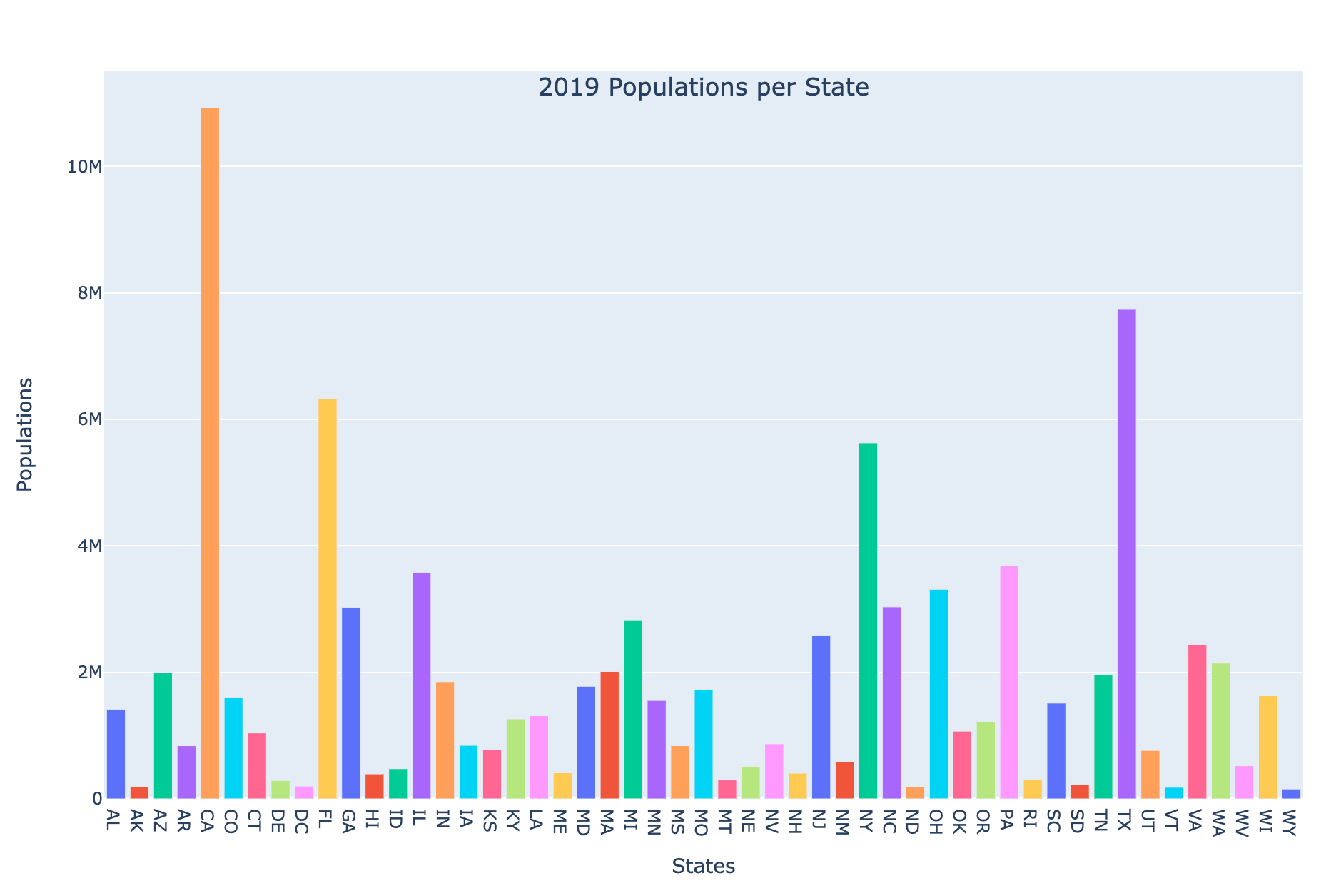
Modeling and Visualization - 2019 Population
Notes:
Aadarsh

Slide 10
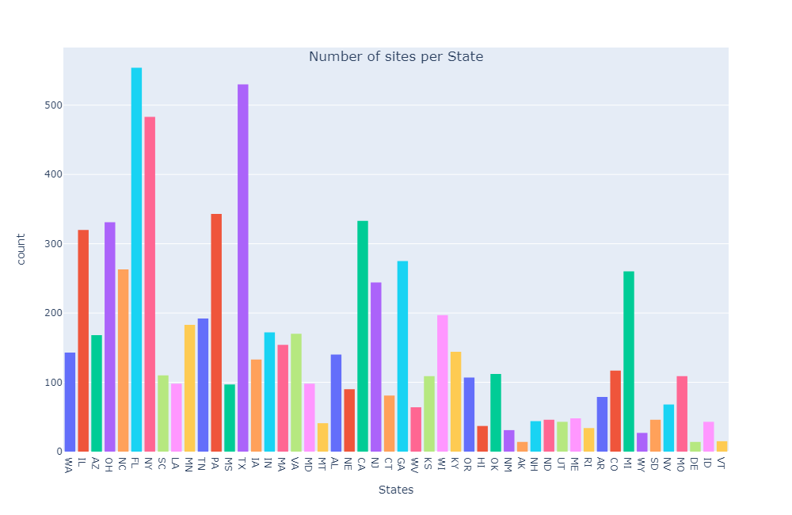
Modeling and Visualization - Facilities Per State
Notes:
Abraar

Slide 11
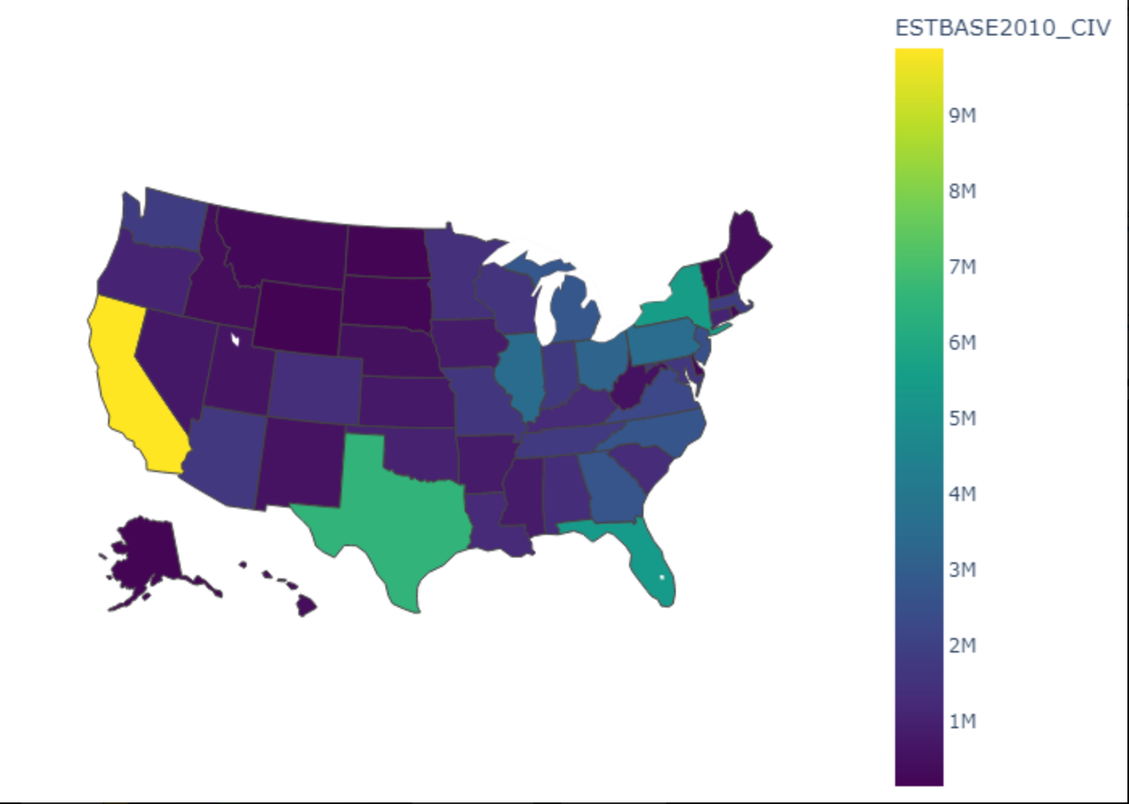
Modeling and Visualization - Estimated Population
of 2010 Choropleth
Notes:
Michael

Slide 12
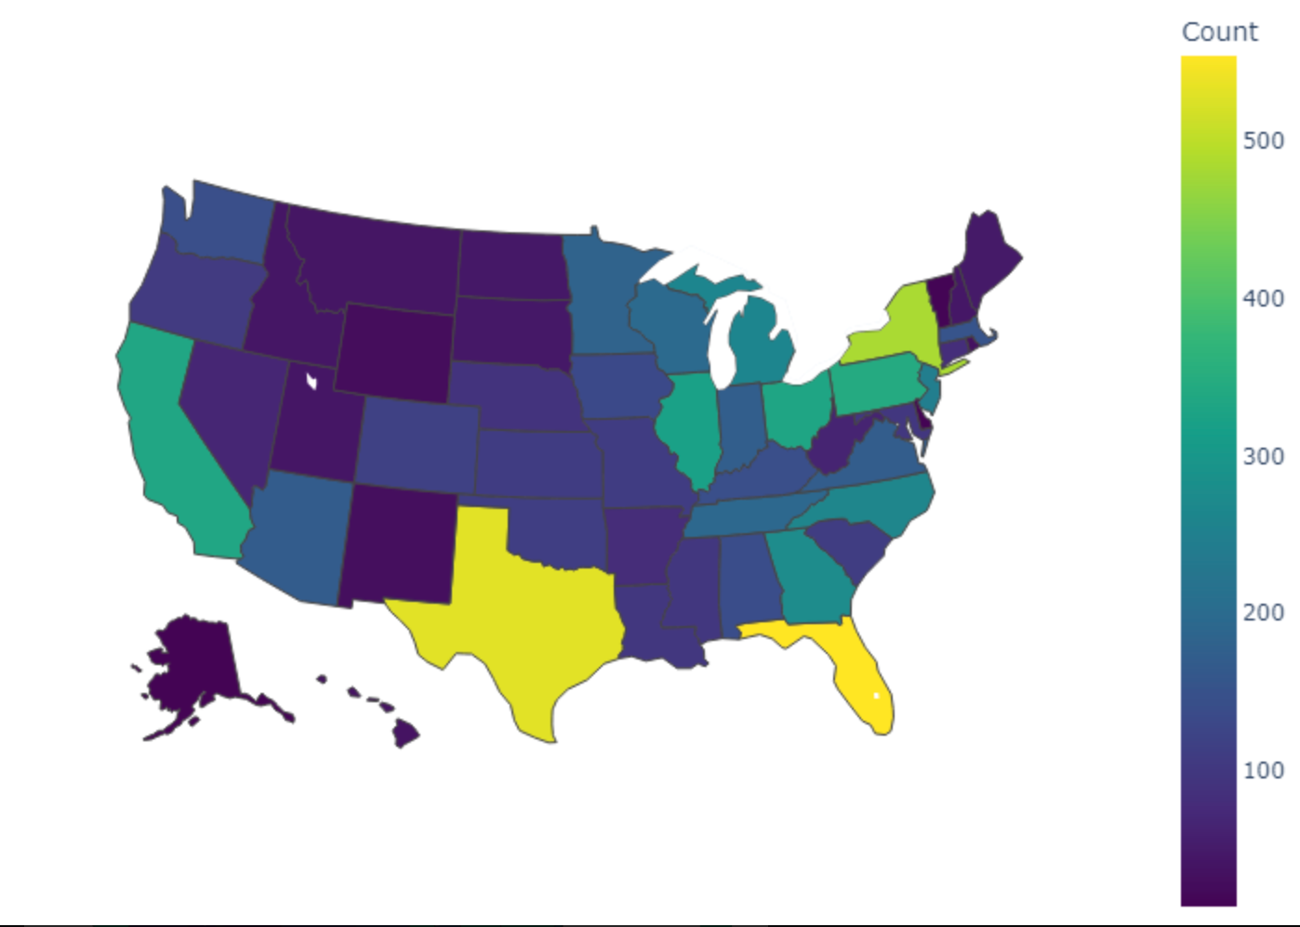
Modeling and Visualization - Number of Facilities in each State Choropleth
Notes:
Michael

Slide 13
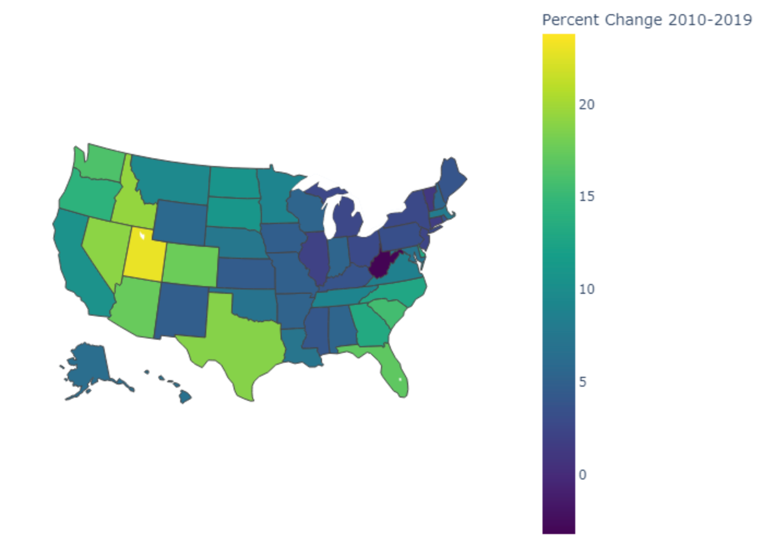
Modeling and Visualization - Percent Change from 2010-2019 Choropleth
Notes:
Michael

Slide 14
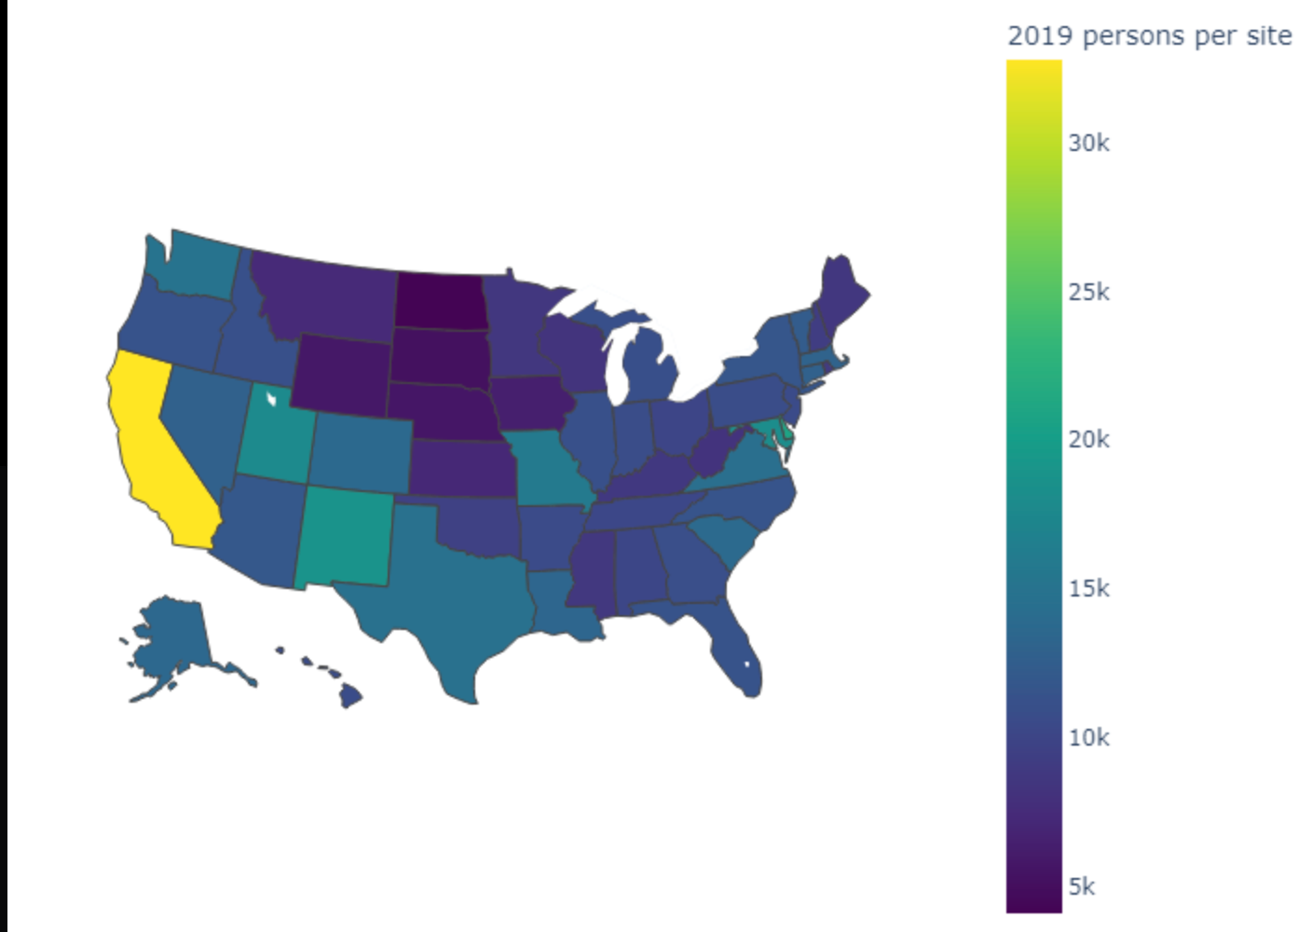
Modeling and Visualization - 2019 Persons per site
Choropleth
Notes:
Michael

Slide 15
Linear Regression Model
Given the data from previous years, we decided to investigate what the population of women with risk of breast cancer would be in the future within each state.
Linear regression was implemented in order to predict the future population requiring facility sites in each state
To train the model, we split the data with 30% testing for each year from 2010-2019.

Slide 16
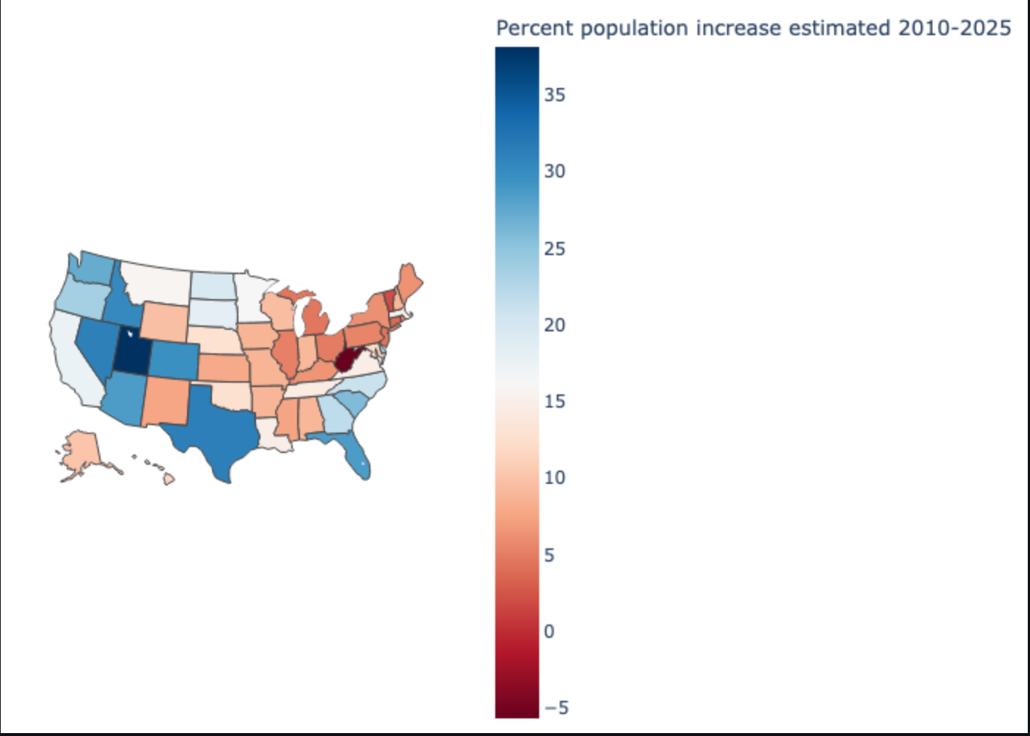
Linear Regression Plot - Percent Change from 2010 to 2025 Choropleth
Notes:
Aadarsh: the blue signifies that these states are expected to have the greatest percent growth and are targets for future investment

Slide 17
Evaluation
According to data collected from all our plots, it is apparent that certain states such as Texas, California, and Florida seem to contain the highest population of women with potential risk of breast cancer as well as greatest amount of facility sites required.
Particular states – Texas, Florida, Nevada, Colorado, Arizona, Idaho, and Washington seem to display the largest estimated population increase in women with potential risk of breast cancer from 2010-2025.
Thus, such states are great targets for future investment.

Slide 18
Members and Contributions

Slide 19

Karthik Kallakuri
Contributions:
Cleaned and Processed data
Assisted with Linear Regression Model
Initiated and worked on Powerpoint

Slide 20

Michael Moorman
Contributions:
Cleaning for sites dataset
Implemented FIPS lookup
Assisted with Linear Regression Model
Helped create choropleth charts

Slide 21

Abraar Patel
Contributions:
Created the README file of GitHUB
Created Google colab for better working environment
Generated the choropleth plots
Created a function which converts plotly graphs to PNG files
Generated bar plots by adding various colors
Pushed changes to GitHub for plotly.py file and pushed all png files for the plotly graphs

Slide 22

Aadarsh Srivatsav
Contributions:
Cleaned and processed data for census.csv
Created bar graphs for 2010, 2015, and 2019 populations per state
Implemented Linear Regression Model for 2025 predictions
Initiated and worked on Powerpoint
Pushed changes to github for plots.py file
Analyzed and evaluated data from all graphs

Slide 23

Thank you for watching
Thank you for listening

